Slide 1


Introduction to Operating Systems CS 1550
Spring 2023
Sherif Khattab
ksm73@pitt.edu
(Some slides are from Silberschatz, Galvin and Gagne ©2013)

Slide 2
Announcements
Upcoming deadlines
Homework 8 is due this Friday: 2 extra attempts
Quiz 2 is this Friday at 11:59 pm
Lab 3 is due on Tuesday 3/28 at 11:59 pm
Project 3 is due Friday 4/7 at 11:59 pm

Slide 3
Previous Lecture …
Memory allocation and protection
Take 1: Variable-size segments, base and limit registers
Take 2: Virtual memory
Fixed-size pages, on-demand, appear as if having more memory that physically in the system

Slide 4
Paging and page tables
Virtual addresses mapped to physical addresses
Unit of mapping is called a page
All addresses in the same virtual page are in the same physical page
Page table entry (PTE) contains translation for a single page
Table translates virtual page number to physical page number
Not all virtual memory has a physical page
Not every physical page need be used
Example:
64 KB virtual memory
32 KB physical memory
60–64K
-
56–60K
-
52–56K
-
48–52K
6
44–48K
5
40–44K
1
36–40K
-
32–36K
-
28–32K
3
28–32K
24–28K
-
24–28K
20–24K
-
20–24K
16–20K
0
16–20K
12–16K
-
12–16K
8–12K
-
8–12K
4–8K
4
4–8K
0–4K
7
0–4K
Virtual address space
Physical memory

Slide 5
What’s in a page table entry?
Each entry in the page table contains
Valid bit: set if this logical page number has a corresponding physical frame in memory
If not valid, remainder of PTE is irrelevant
Page frame number: page in physical memory
Referenced bit: set if data on the page has been accessed
Dirty (modified) bit :set if data on the page has been modified
Protection information
Protection
D
R
V
Page frame number
Dirty bit
Referenced bit
Valid bit

Slide 6
Implementing page tables in hardware
Page table resides in main (physical) memory
CPU uses special registers for paging
Page table base register (PTBR) points to the page table
Page table length register (PTLR) contains length of page table: restricts maximum legal logical address
Translating an address requires two memory accesses
First access reads page table entry (PTE)
Second access reads the data / instruction from memory
Reduce number of memory accesses
Can’t avoid second access (we need the value from memory)
Eliminate first access by keeping a hardware cache (called a translation lookaside buffer or TLB) of recently used page table entries

Slide 7
Problem of the Day
Page fault forces a choice
No room for new page (steady state)
A page must be removed to make room for an incoming page.
Which page to select?
Victim page
Evicted/purged

Slide 8
Page replacement algorithms
How is a page removed from physical memory?
If the page is unmodified, simply overwrite it: a copy already exists on disk
If the page has been modified, it must be written back to disk: prefer unmodified pages?
Better not to choose an often used page
It’ll probably need to be brought back in soon

Slide 9
Optimal page replacement algorithm
What’s the best we can possibly do?
Assume perfect knowledge of the future
Not realizable in practice (usually)
Useful for comparison: if another algorithm is within 5% of optimal, not much more can be done…
Algorithm: replace the page that will be used furthest in the future
Only works if we know the whole sequence!
Can be approximated by running the program twice
Once to generate the reference trace
Once (or more) to apply the optimal algorithm
Nice, but not achievable in real systems!

Slide 10
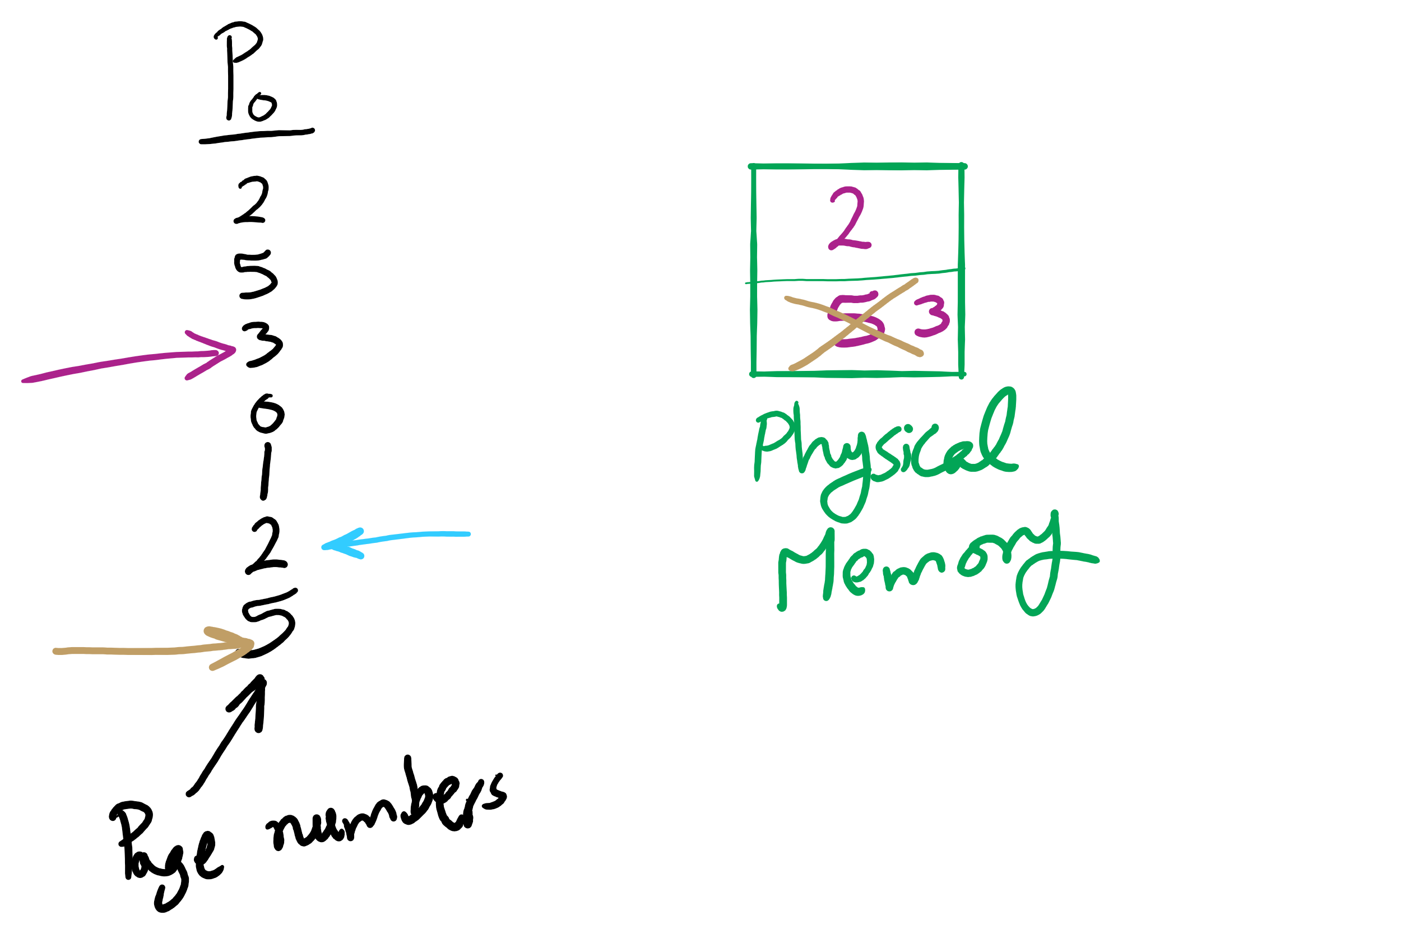
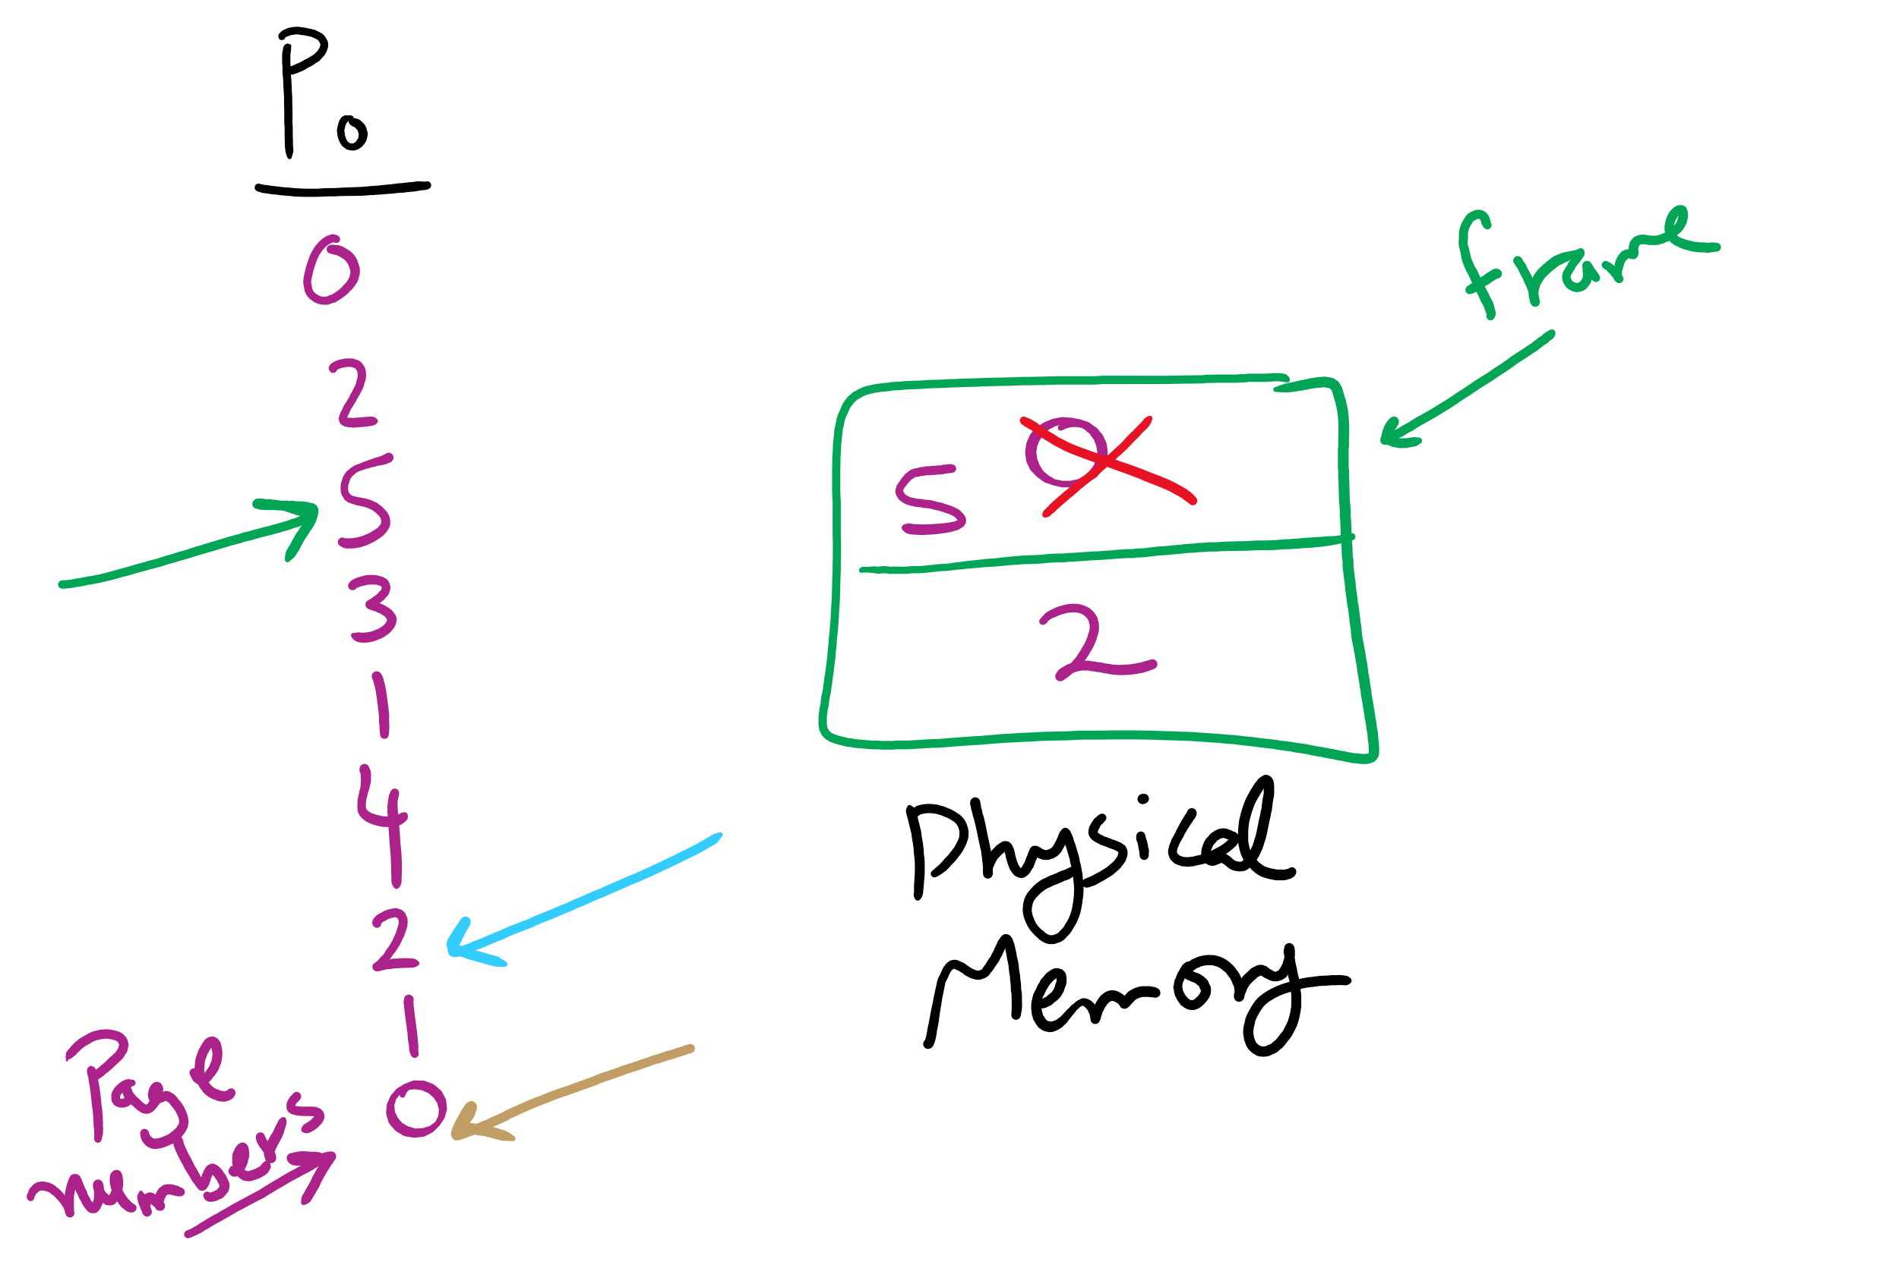
OPT Examples

Slide 11
Not-recently-used (NRU) algorithm
Each page has reference bit and dirty bit
Bits are set when page is referenced and/or modified
Pages are classified into four classes
0: not referenced, not dirty
1: not referenced, dirty
2: referenced, not dirty
3: referenced, dirty
Clear reference bit for all pages periodically
Can’t clear dirty bit: needed to indicate which pages need to be flushed to disk
Class 1 contains dirty pages where reference bit has been cleared
Algorithm: remove a page from the lowest non-empty class
Select a page at random from that class
Easy to understand and implement
Performance adequate (though not optimal)

Slide 12
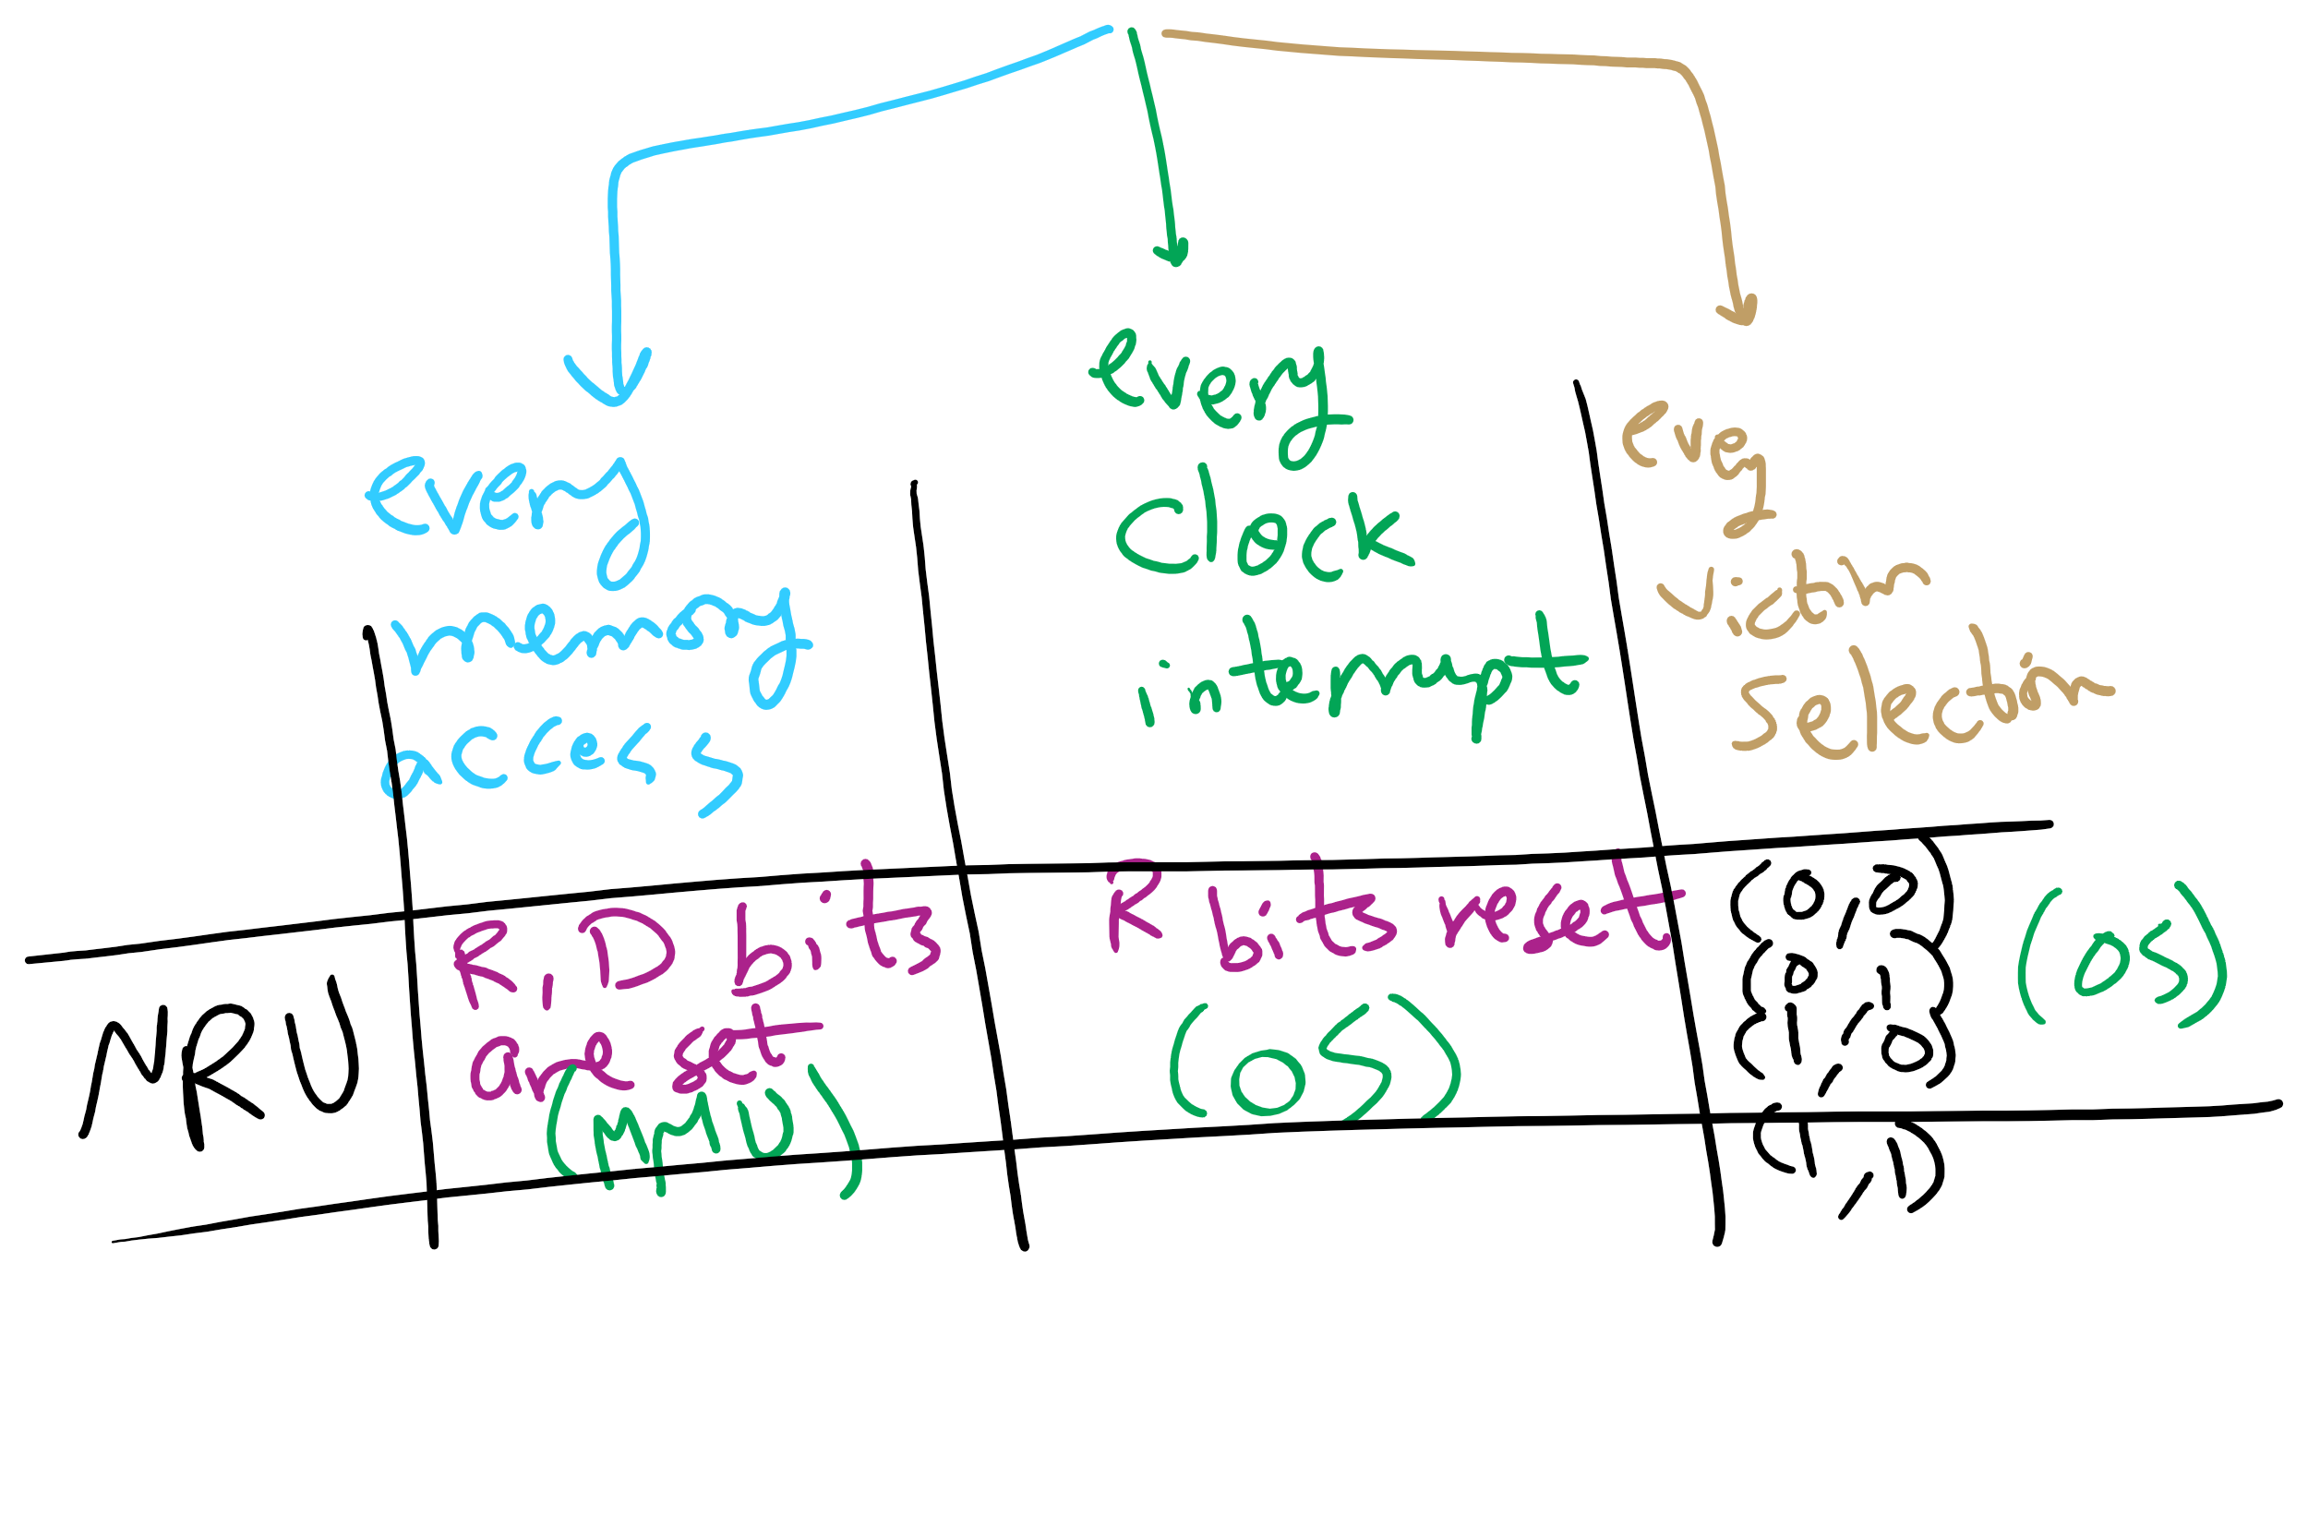
NRU Operation

Slide 13
First-In, First-Out (FIFO) algorithm
Maintain a linked list of all pages
Maintain the order in which they entered memory
Page at front of list replaced
Advantage: (really) easy to implement
Disadvantage: page in memory the longest may be often used
This algorithm forces pages out regardless of usage
Usage may be helpful in determining which pages to keep

Slide 14
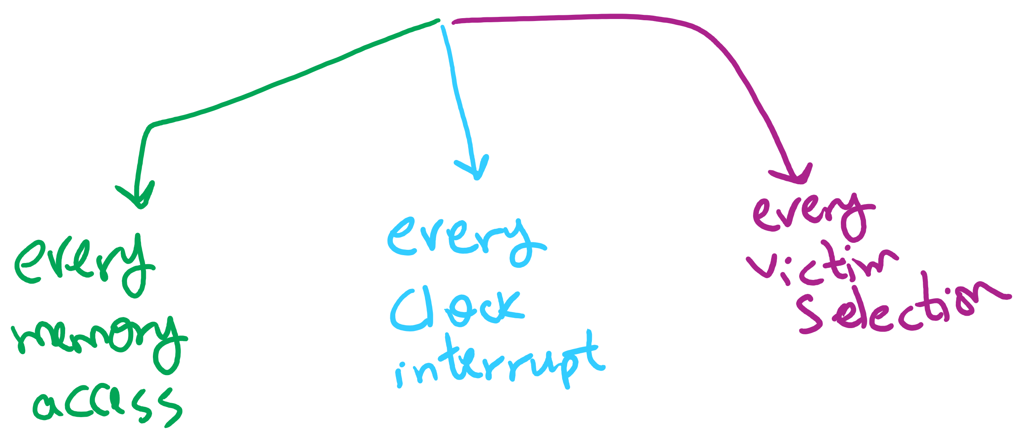
Page Replacement Algorithms Components

Slide 15
Second chance page replacement
Modify FIFO to avoid throwing out heavily used pages
If reference bit is 0, throw the page out
If reference bit is 1
Reset the reference bit to 0
Move page to the tail of the list
Continue search for a free page
Still easy to implement, and better than plain FIFO
referenced
unreferenced
A t=0
B t=4
C t=8
D t=15
E t=21
F t=22
G t=29
H t=30
A t=32

Slide 16
Clock algorithm
Same functionality as second chance
Simpler implementation
“Clock” hand points to next page to replace
If R=0, replace page
If R=1, set R=0 and advance the clock hand
Continue until page with R=0 is found
This may involve going all the way around the clock…
A t=0
A t=32
H t=30
B t=4
B t=32
G t=29
C t=8
C t=32
F t=22
D t=15
J t=32
E t=21
referenced
unreferenced

Slide 17
Least Recently Used (LRU)
Assume pages used recently will be used again soon
Throw out page that has been unused for longest time
Must keep a linked list of pages
Most recently used at front, least at rear
Update this list every memory reference!
This can be somewhat slow: hardware has to update a linked list on every reference!
Alternatively, keep counter in each page table entry
Global counter increments with each CPU cycle
Copy global counter to PTE counter on a reference to the page
For replacement, evict page with lowest counter value

Slide 18
Simulating LRU in software
Few computers have the necessary hardware to implement full LRU
Linked-list method impractical in hardware
Counter-based method could be done, but it’s slow to find the desired page
Approximate LRU with Not Frequently Used (NFU) algorithm
At each clock interrupt, scan through page table
If R=1 for a page, add one to its counter value
On replacement, pick the page with the lowest counter value
Problem: no notion of age—pages with high counter values will tend to keep them!

Slide 19
Aging replacement algorithm
Reduce counter values over time
Divide by two every clock cycle (use right shift)
More weight given to more recent references!
Select page to be evicted by finding the lowest counter value
Algorithm is:
Every clock tick, shift all counters right by 1 bit
On reference, set leftmost bit of a counter (can be done by copying the reference bit to the counter at the clock tick)
Referenced this tick
Tick 0
Tick 1
Tick 2
Tick 3
Tick 4
Page 0
10000000
11000000
11100000
01110000
10111000
Page 1
00000000
10000000
01000000
00100000
00010000
Page 2
10000000
01000000
00100000
10010000
01001000
Page 3
00000000
00000000
00000000
10000000
01000000
Page 4
10000000
01000000
10100000
11010000
01101000
Page 5
10000000
11000000
01100000
10110000
11011000

Slide 20
Working set
Demand paging: bring a page into memory when it’s requested by the process
How many pages are needed?
Could be all of them, but not likely
Instead, processes reference a small set of pages at any given time—locality of reference
Set of pages can be different for different processes or even different times in the running of a single process
Set of pages used by a process in a given interval of time is called the working set
If entire working set is in memory, no page faults!
If insufficient space for working set, thrashing may occur
Goal: keep most of working set in memory to minimize the number of page faults suffered by a process

Slide 21
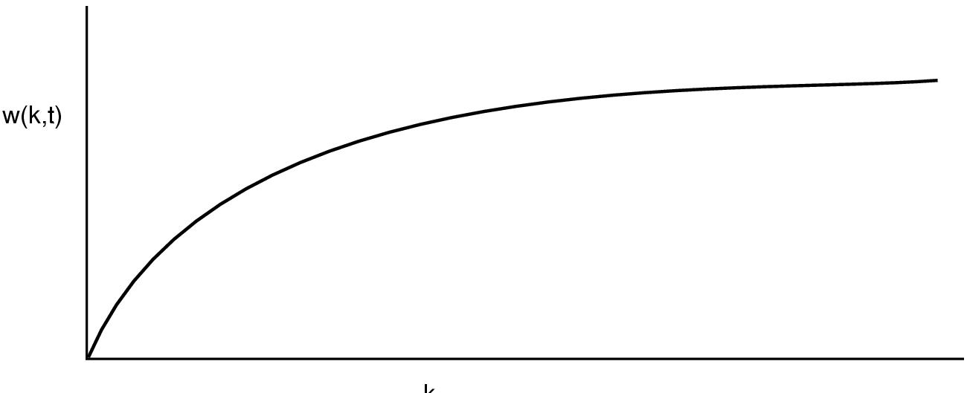
How big is the working set?
w(k,t)
k
Working set is the set of pages used by the k most recent memory references
w(k,t) is the size of the working set at time t
Working set may change over time
Size of working set can change over time as well…

Slide 22
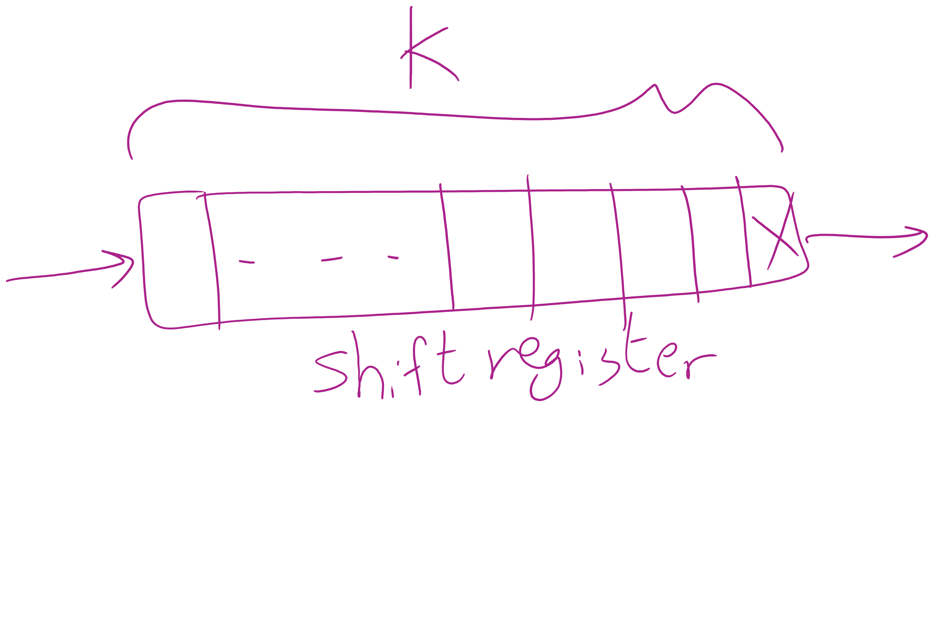
Keeping track of the Working Set

Slide 23
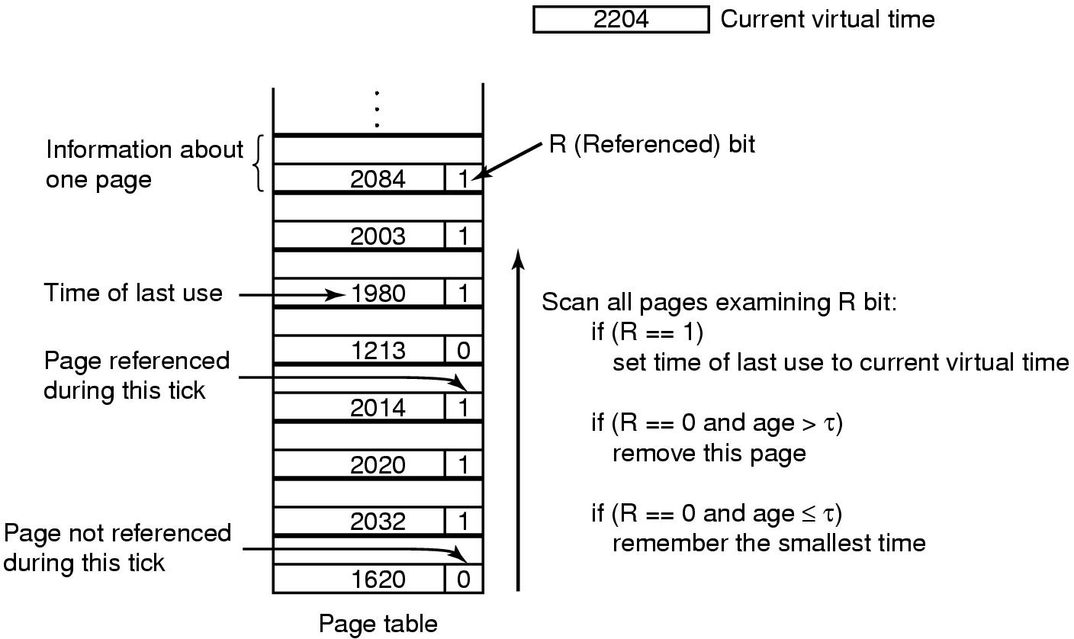
Working set page replacement algorithm

Slide 24
Summary
Page replacement algorithms
Algorithm | Comment
OPT (Optimal) | Not implementable, but useful as a benchmark
NRU (Not Recently Used) | Crude
FIFO (First-In, First Out) | Might throw out useful pages
Second chance | Big improvement over FIFO
Clock | Better implementation of second chance
LRU (Least Recently Used) | Excellent, but hard to implement exactly
NFU (Not Frequently Used) | Poor approximation to LRU
Aging | Good approximation to LRU, efficient to implement
Working Set | Somewhat expensive to implement
WSClock | Implementable version of Working Set

Slide 25
Algorithm Simulation
How to simulate page replacement algorithms
FIFO/Clock
LRU, OPT

Slide 26
How is modeling done?
Generate a list of references
Artificial (made up)
Trace a real workload (set of processes)
Use an array (or other structure) to track the pages in physical memory at any given time
May keep other information per page to help simulate the algorithm (modification time, time when paged in, etc.)
Run through references, applying the replacement algorithm
Example: FIFO replacement on reference string 0 1 2 3 0 1 4 0 1 2 3 4
Page replacements highlighted in yellow
Page referenced |  | 0 | 1 | 2 | 3 | 0 | 1 | 4 | 0 | 1 | 2 | 3 | 4
Youngest page |  | 0 | 1 | 2 | 3 | 0 | 1 | 4 | 4 | 4 | 2 | 3 | 3
 |  |  | 0 | 1 | 2 | 3 | 0 | 1 | 1 | 1 | 4 | 2 | 2
Oldest page |  |  |  | 0 | 1 | 2 | 3 | 0 | 0 | 0 | 1 | 4 | 4

Slide 27
Interactive Simulation Tool
https://sim-50.github.io/cs-tools/

Slide 28
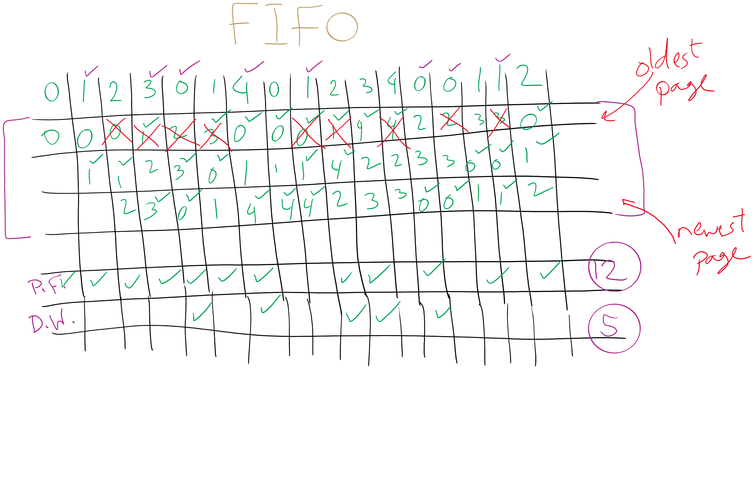
FIFO with 3 frames

Slide 29
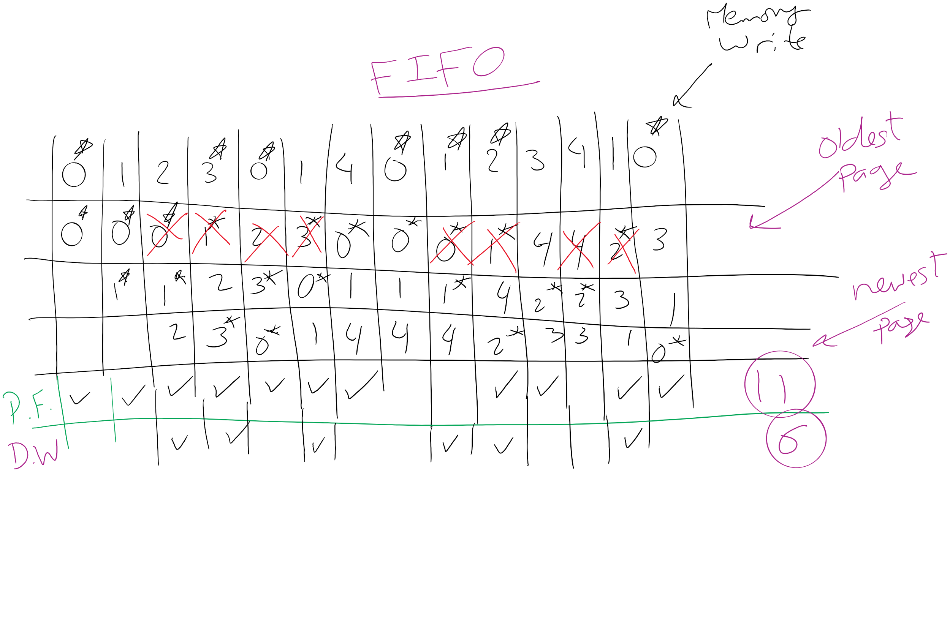
FIFO Example 1

Slide 30
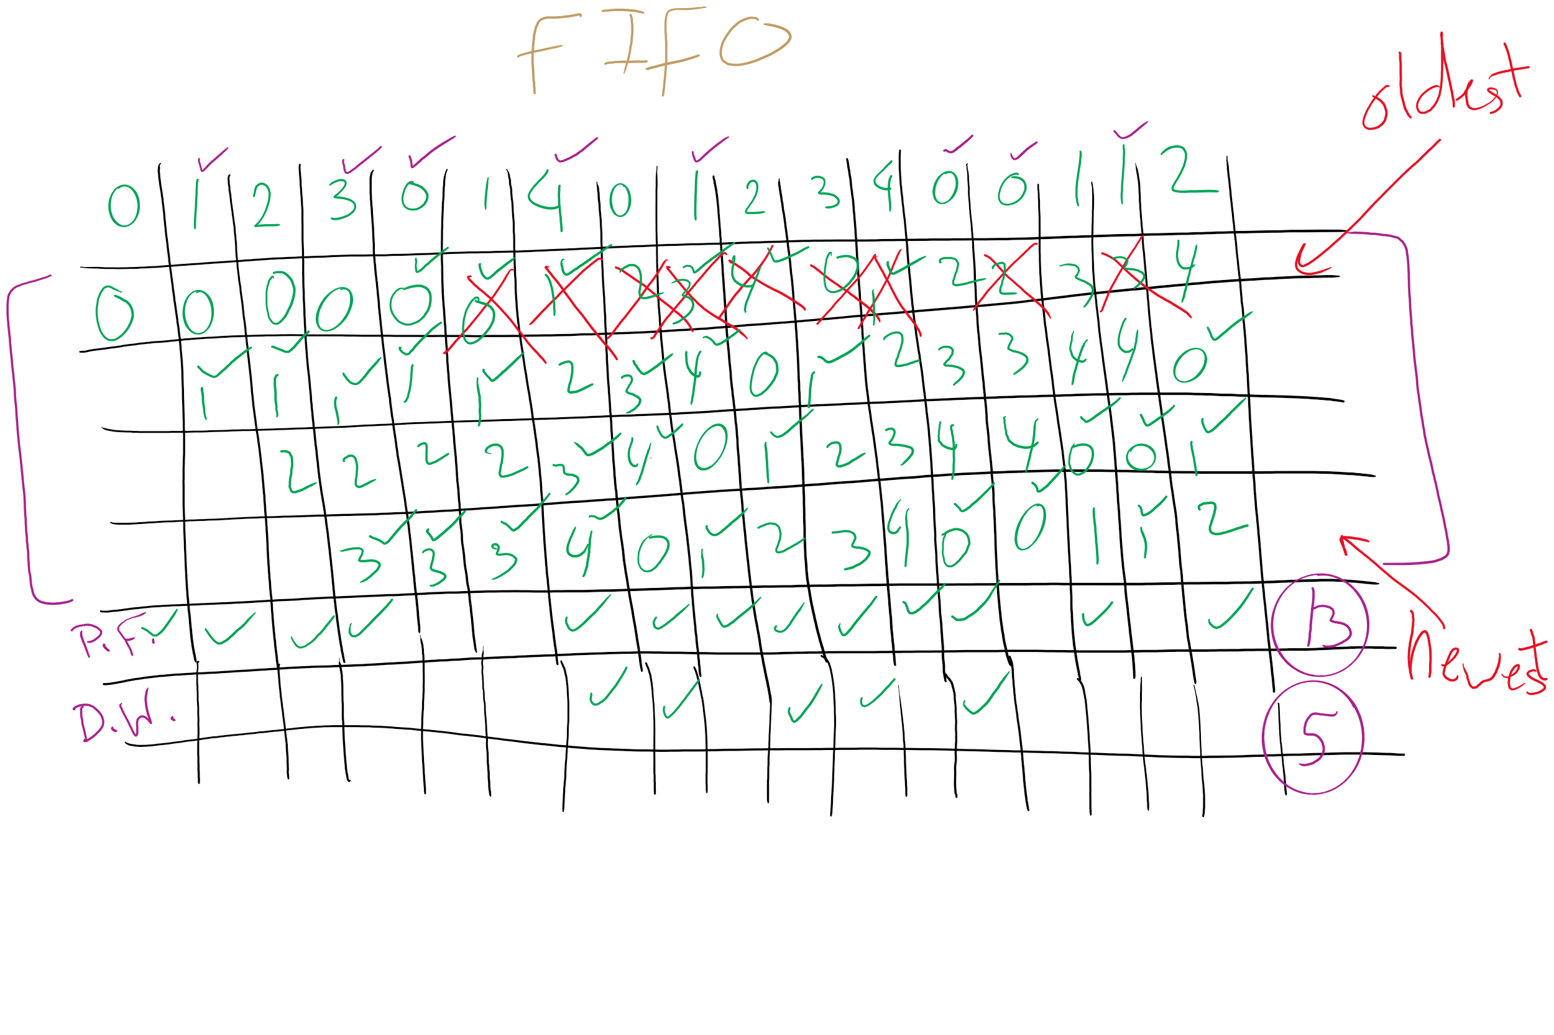
FIFO with 4 frames

Slide 31
Belady’s anomaly
Reduce the number of page faults by supplying more memory
Use previous reference string and FIFO algorithm
Add another page to physical memory (total 4 pages)
More page faults (10 vs. 9), not fewer!
This is called Belady’s anomaly
Adding more pages shouldn’t result in worse performance!
Motivated the study of paging algorithms

Slide 32
CLOCK Simulation

Slide 33
Modeling more replacement algorithms
Paging system characterized by:
Reference string of executing process
Page replacement algorithm
Number of page frames available in physical memory (m)
Model this by keeping track of all n pages referenced in array M
Top part of M has m pages in memory
Bottom part of M has n-m pages stored on disk
Page replacement occurs when page moves from top to bottom
Top and bottom parts may be rearranged without causing movement between memory and disk

Slide 34
Example: LRU
Model LRU replacement with
8 unique references in the reference string
4 pages of physical memory
Array state over time shown below
LRU treats list of pages like a stack
 | 0 | 2 | 1 | 3 | 5 | 4 | 6 | 3 | 7 | 4 | 7 | 3 | 3 | 5 | 5 | 3 | 1 | 1 | 1 | 7 | 1 | 3 | 4 | 1
 | 0 | 2 | 1 | 3 | 5 | 4 | 6 | 3 | 7 | 4 | 7 | 3 | 3 | 5 | 5 | 3 | 1 | 1 | 1 | 7 | 1 | 3 | 4 | 1
 |  | 0 | 2 | 1 | 3 | 5 | 4 | 6 | 3 | 7 | 4 | 7 | 7 | 3 | 3 | 5 | 3 | 3 | 3 | 1 | 7 | 1 | 3 | 4
 |  |  | 0 | 2 | 1 | 3 | 5 | 4 | 6 | 3 | 3 | 4 | 4 | 7 | 7 | 7 | 5 | 5 | 5 | 3 | 3 | 7 | 1 | 3
 |  |  |  | 0 | 2 | 1 | 3 | 5 | 4 | 6 | 6 | 6 | 6 | 4 | 4 | 4 | 7 | 7 | 7 | 5 | 5 | 5 | 7 | 7
 |  |  |  |  | 0 | 2 | 1 | 1 | 5 | 5 | 5 | 5 | 5 | 6 | 6 | 6 | 4 | 4 | 4 | 4 | 4 | 4 | 5 | 5
 |  |  |  |  |  | 0 | 2 | 2 | 1 | 1 | 1 | 1 | 1 | 1 | 1 | 1 | 6 | 6 | 6 | 6 | 6 | 6 | 6 | 6
 |  |  |  |  |  |  | 0 | 0 | 2 | 2 | 2 | 2 | 2 | 2 | 2 | 2 | 2 | 2 | 2 | 2 | 2 | 2 | 2 | 2
 |  |  |  |  |  |  |  |  | 0 | 0 | 0 | 0 | 0 | 0 | 0 | 0 | 0 | 0 | 0 | 0 | 0 | 0 | 0 | 0

Slide 35
Stack algorithms
LRU is an example of a stack algorithm
For stack algorithms
Any page in memory with m physical pages is also in memory with m+1 physical pages
Increasing memory size is guaranteed to reduce (or at least not increase) the number of page faults
Stack algorithms do not suffer from Belady’s anomaly
Distance of a reference == position of the page in the stack before the reference was made
Distance is ∞ if no reference had been made before
Distance depends on reference string and paging algorithm: might be different for LRU and optimal (both stack algorithms)

Slide 36
Predicting page fault rates using distance
Distance can be used to predict page fault rates
Make a single pass over the reference string to generate the distance string on-the-fly
Keep an array of counts
Entry j counts the number of times distance j occurs in the distance string
The number of page faults for a memory of size m is the sum of the counts for j>m
This can be done in a single pass!
Makes for fast simulations of page replacement algorithms
This is why virtual memory theorists like stack algorithms!

Slide 37
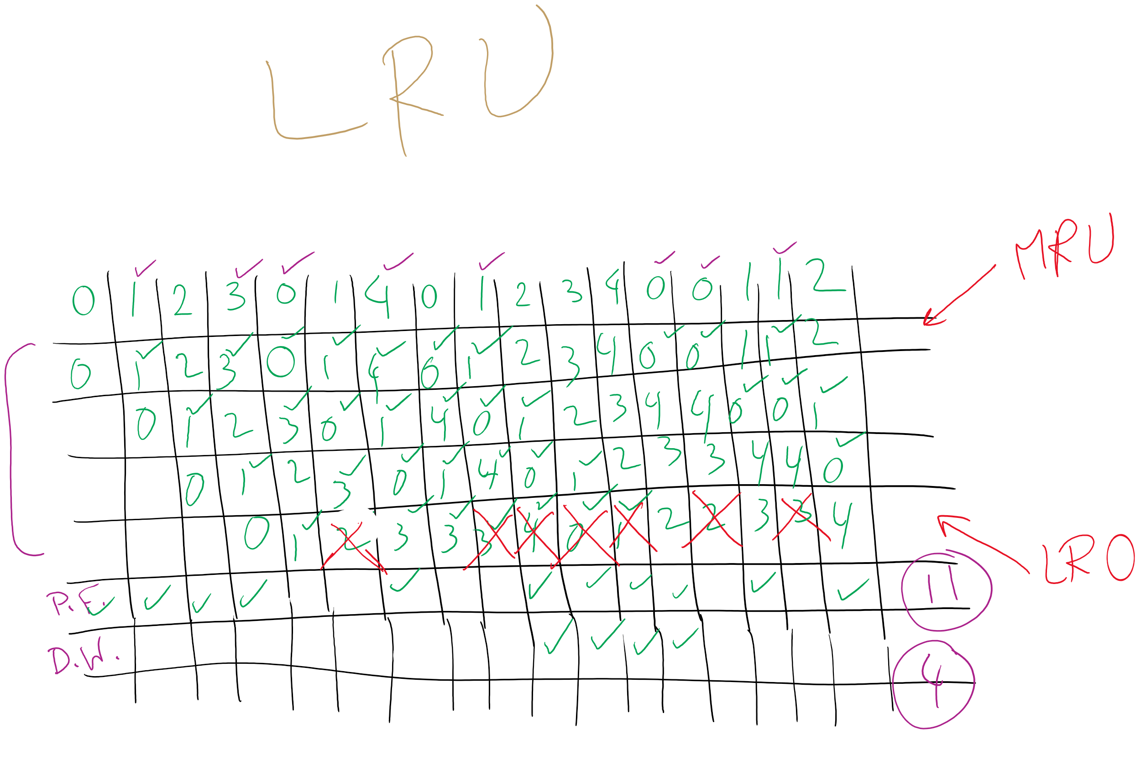
LRU

Slide 38
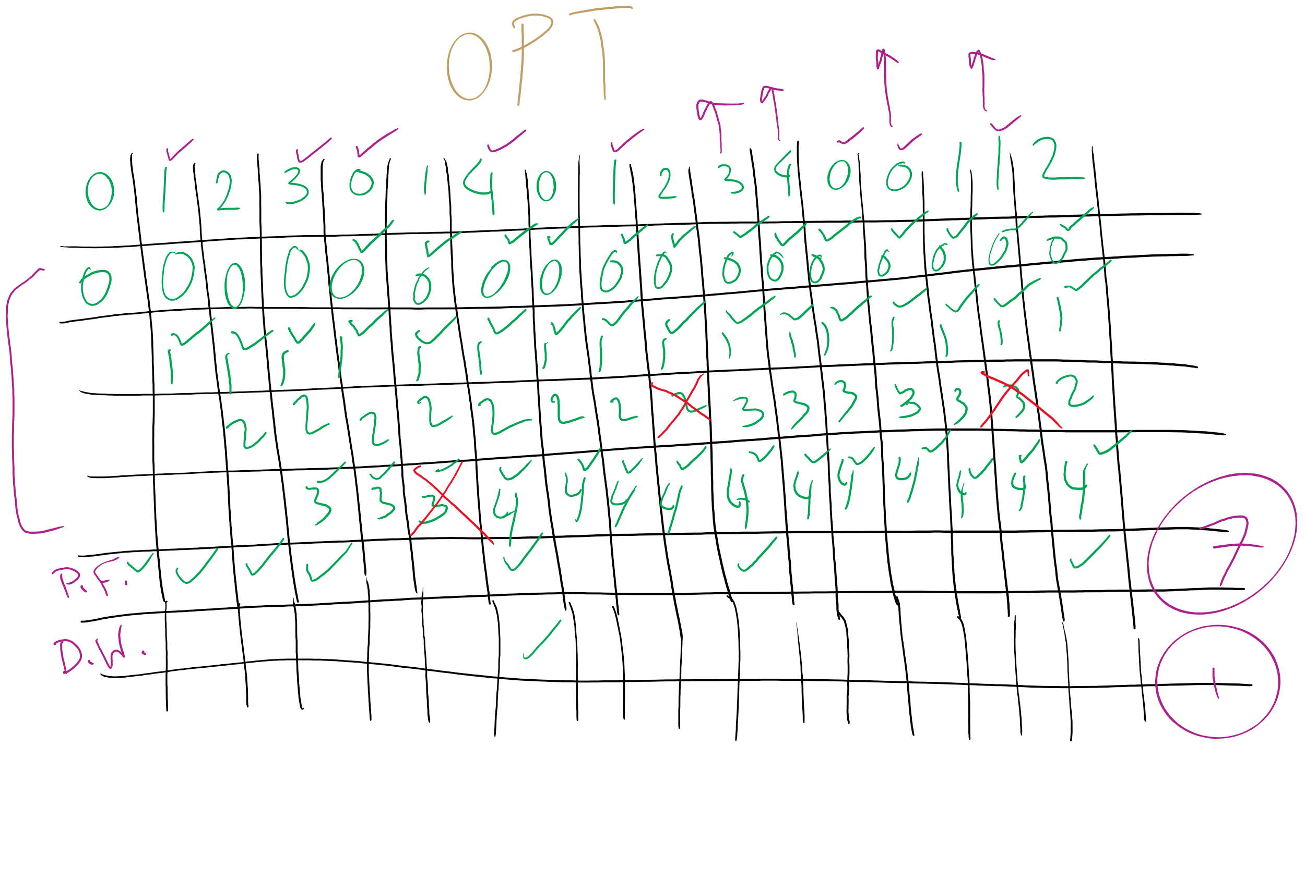
OPT

